Slide 1
CASE STUDY Bank Direct Marketing Classification Problem
20261A3235
20261A3243
20261A3244
20261A3253

Slide 2
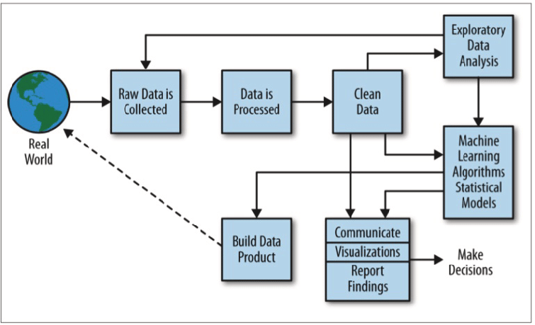
Data Science Process

Slide 3
Case Study
Title-Bank Direct Marketing Campaigns
Problem Statement-The data is related with direct marketing campaigns (phone calls) of a Portuguese banking institution. The classification goal is to predict if the client will subscribe a term deposit (variable y).
There are 20 columns in a Bank Direct Marketing classification.Each columns are described as follows.
The data set consist of 41929 rows and 12 columns which is concised into 2500 rows and 12 columns

Slide 4
Description of columns:
Age (numeric)
Job : type of job (categorical: 'admin.', 'blue-collar', 'entrepreneur', 'housemaid', 'management', 'retired', 'self-employed', 'services', 'student', 'technician', 'unemployed', 'unknown')
Marital : marital status (categorical: 'divorced', 'married', 'single', 'unknown' ; note: 'divorced' means divorced or widowed)
Education (categorical: 'basic.4y', 'basic.6y', 'basic.9y', 'high.school', 'illiterate', 'professional.course', 'university.degree', 'unknown')
Default: has credit in default? (categorical: 'no', 'yes', 'unknown')
Housing: has housing loan? (categorical: 'no', 'yes', 'unknown')
Loan: has personal loan? (categorical: 'no', 'yes', 'unknown’)
Contact: contact communication type (categorical: 'cellular','telephone')
Month: last contact month (categorical: 'jan', 'feb', 'mar', ..., 'nov', 'dec')
Day_of_week: last contact day of the week (categorical: 'mon','tue','wed','thu','fri')
Campaign: number of contacts performed during this campaign and for this client (numeric, includes last contact)

Slide 5
Analysis from Bank Direct Marketing
Classification Data set
1.Predict if the client will subscribe a term deposit (variable y).
2.Which category of customers are most likely to do a term deposit.
3.If number of term deposits are more, It can increase its operational risk by having less staff to serve customers. How that has to be managed properly?
4.How campaigning can influence client?

Slide 6
Cleaning Data Set
1.Remove duplicate or irrelevant observations from data set.
2.Fix structural errors and unnecessary expressions.
3.Filter unwanted outliers in data set.
4.Handle missing data.
5.Validate and QA.
Cleaning data can be done through
Data.isnull()
Data.isna().any().sum()

Slide 7
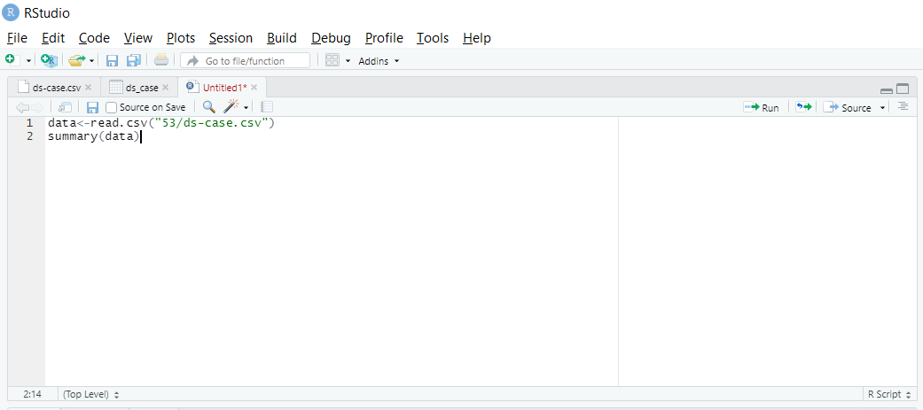
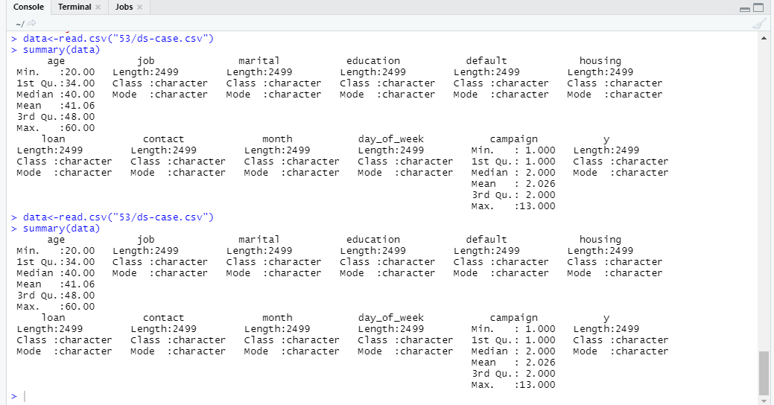
Exploratory Data Analysis(EDA)
EDA is a statistical approach or technique for analyzing data sets in order to summarize their important and main characteristics generally by using some visual aids.
1.Summarize the Data
We can use the summary() function to quickly summarize each variable in the dataset:

Slide 8
2.Structure of data
We can use the str() function to quickly compactly displaying the internal structure of a R object
3.Analyzing relationships between variables
We can analyze using
cor(x, y, method) Parameters: x, y: Data vectors. method: Type of method to be used,
cov(x, y, method) Parameters: x, y: Data vectors. method: Type of method to be used functions.

Slide 9
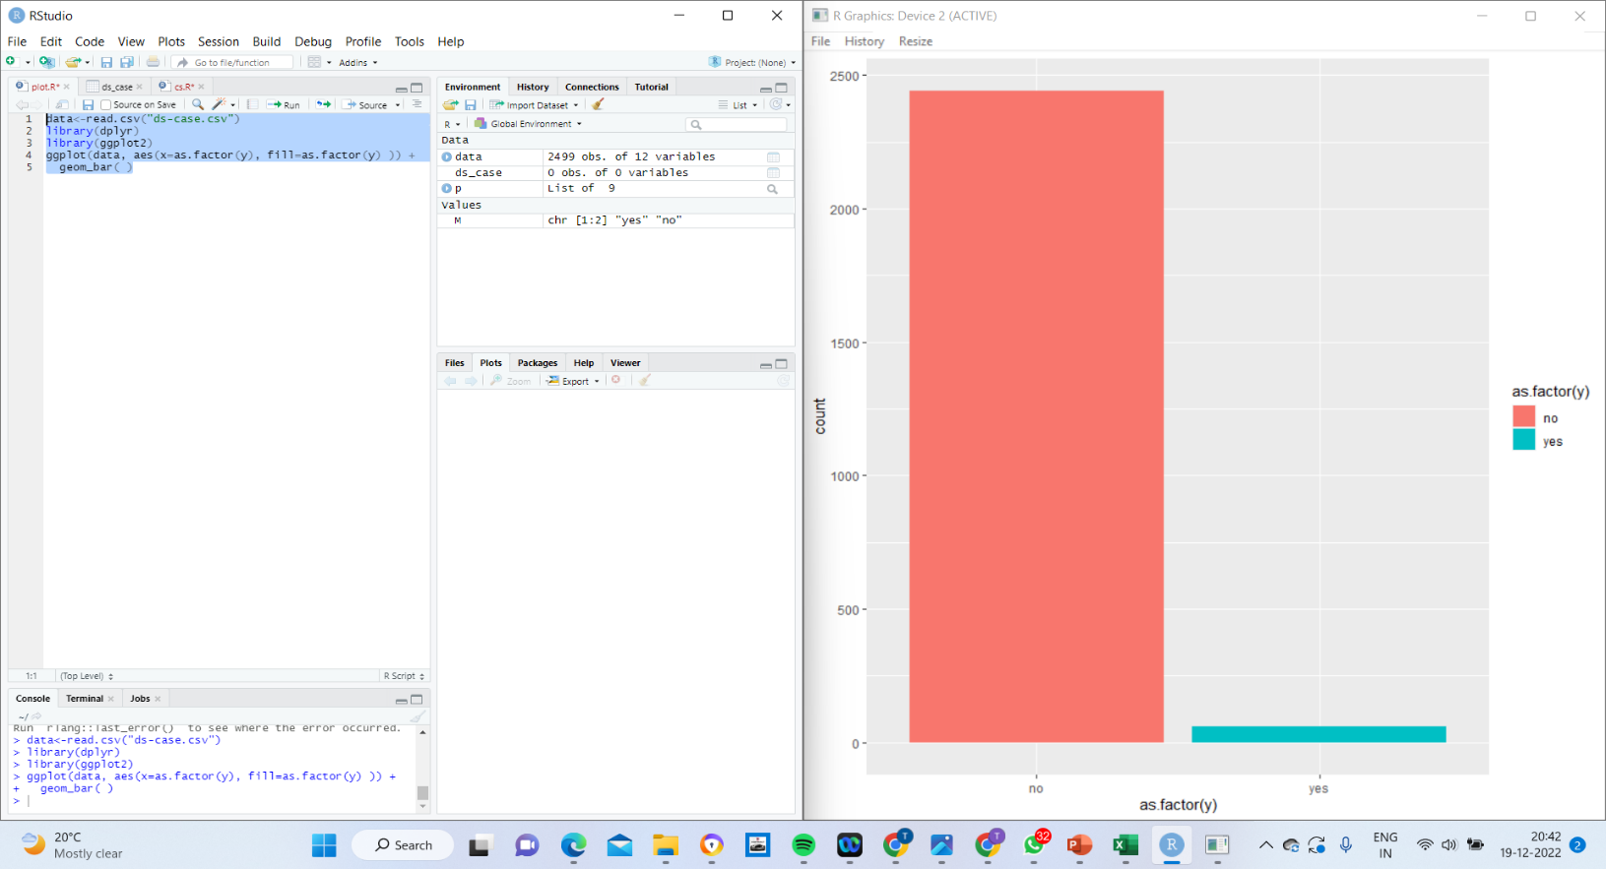
4.Visualization
A variable is categorical if it can only take one of a small set of values. categorical variables are usually saved as factors or character vectors .Since data set contains categorical factor, The data is plotted using bar graph. Data is highly imbalanced. The number of people saying no to term deposit is more than people saying yes.

Slide 10
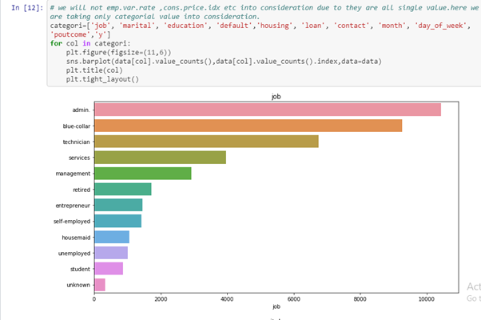
1.Job
More job types are admin, Technicians, and blue-collar and it mean bank targeting high salaried people.

Slide 11
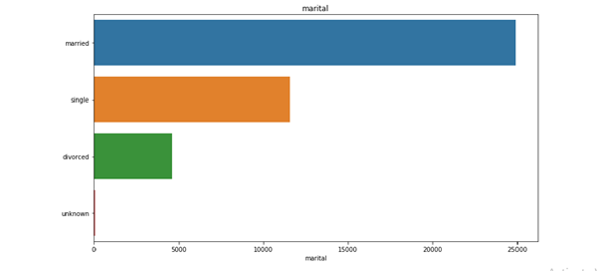
2.Marital Status
Married people are more likely to subscribe to a term deposit compared to singles and divorced people.

Slide 12
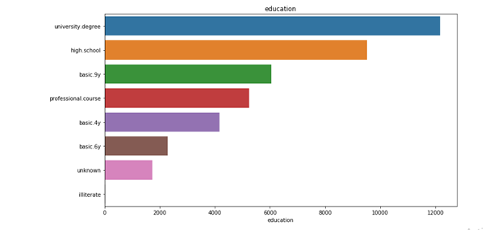
3.Education
More count in university . Degree people , of course , High salaried people should have university degrees expected. And the illiterate count is very less.

Slide 13
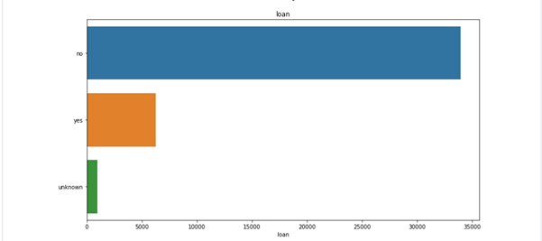
4.Housing
We have to give more importance to people who have not taken any housing loan.

Slide 14
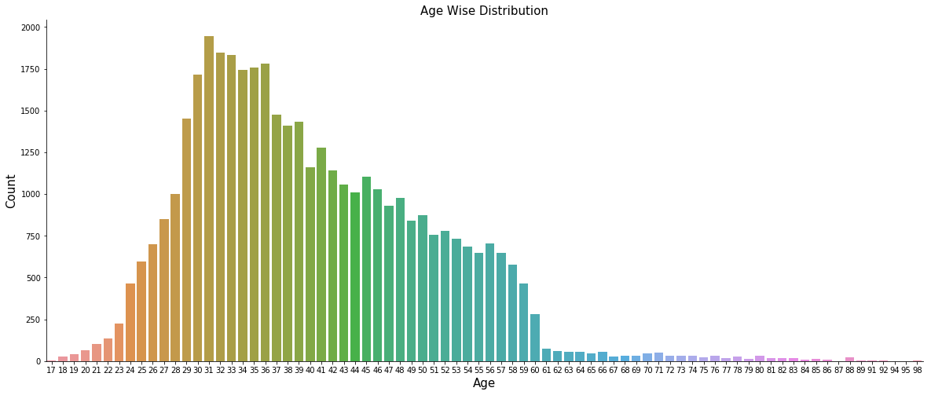
5.Age
People around 30-40(i.e middle age) are given more priority,40-50 comes next. Then people <30 years old are taken.

Slide 15
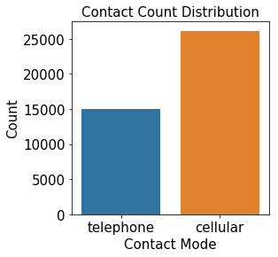
6.Contact
More preference is for cellular users rather than telephone users.

Slide 16
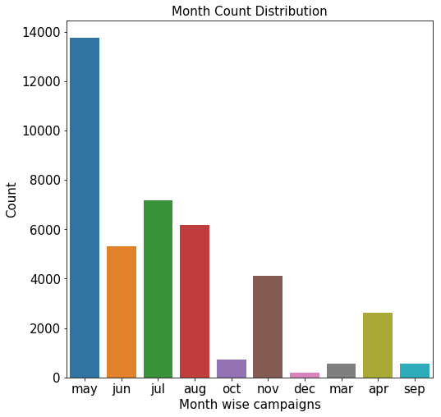
7.Month
During May month there is high chance of getting term deposits. Jul, aug, jun, nov have next prior chances.

Slide 17
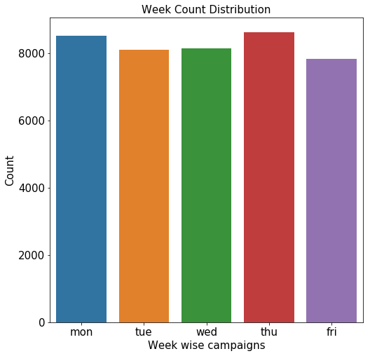
8.Week
Every day of week except weekend have equal chances for client to subscribe a term deposit or not.

Slide 18
Prediction
Logistic Regression is used when the dependent variable(target) is categorical. Bank Direct Marketing classification data can be easily predicted using Logistic Regression Algorithm. There are many categorical columns such as Job, Marital status, education, Housing, loan, campaign which is used to predict if a person will subscribe to term deposit or not using barplot function.
Linear Regression deals with continuous values whereas classification problems mandate discrete values. Hence linear regression is not used.
KNN doesn't work great in general when features are on different scales. This is especially true when one of the 'scales' is a category label. Thus It is not used.
The k-Means algorithm is not applicable to categorical data, as categorical variables are discrete and do not have any natural origin. So computing euclidean distance for such as space is not meaningful. So k-Means is not used.

